Slide 1
Estimation
Chapter 9

Slide 2
Chapter 9
Chapter 9 introduces us to the other main tool of statistical inference: confidence intervals (also called estimation).
In 9.3, we will talk about some general estimation ideas. Then in 9.4 and 9.5, we discuss confidence intervals for a single mean. Then we cover confidence intervals for two means, one proportion, and two proportions in 9.8, 9.10, and 9.11, respectively.

Slide 3
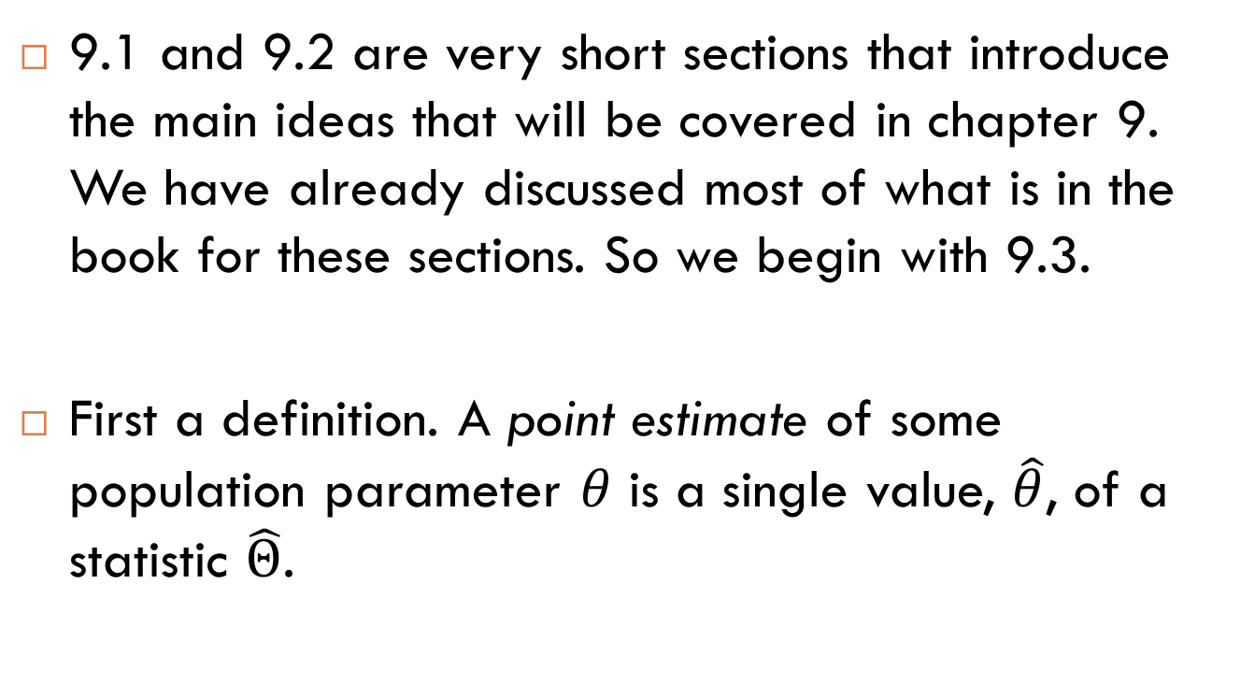
9.3 – Classical Estimation
9.1 and 9.2 are very short sections that introduce the main ideas that will be covered in chapter 9. We have already discussed most of what is in the book for these sections. So we begin with 9.3.
First a definition. A point estimate of some population parameter $θ$ is a single value, $\hat{θ}$, of a statistic $\hat{Θ}$.

Slide 4
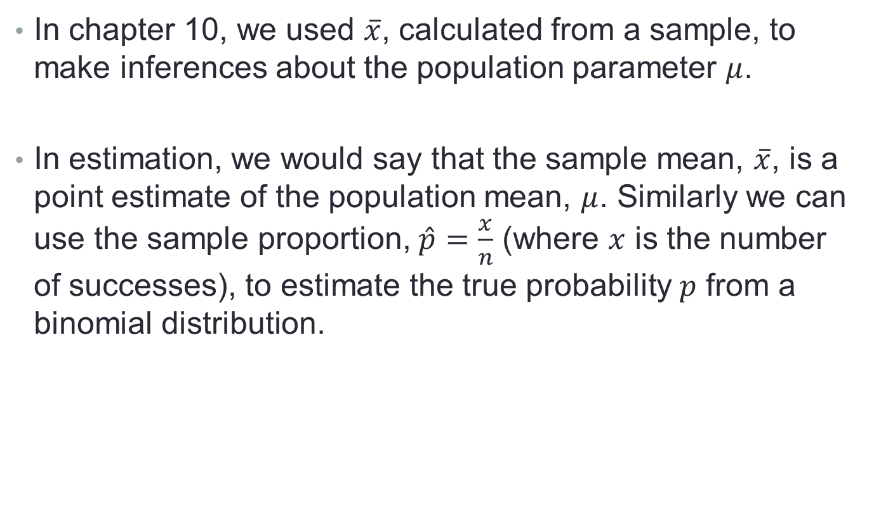
9.3 – Classical Estimation
In chapter 10, we used $\overline{x}$, calculated from a sample, to make inferences about the population parameter $μ$.
In estimation, we would say that the sample mean, $\overline{x}$, is a point estimate of the population mean, $μ$. Similarly we can use the sample proportion, $\hat{p}=\frac{x}{n}$ (where $x$ is the number of successes), to estimate the true probability $p$ from a binomial distribution.

Slide 5
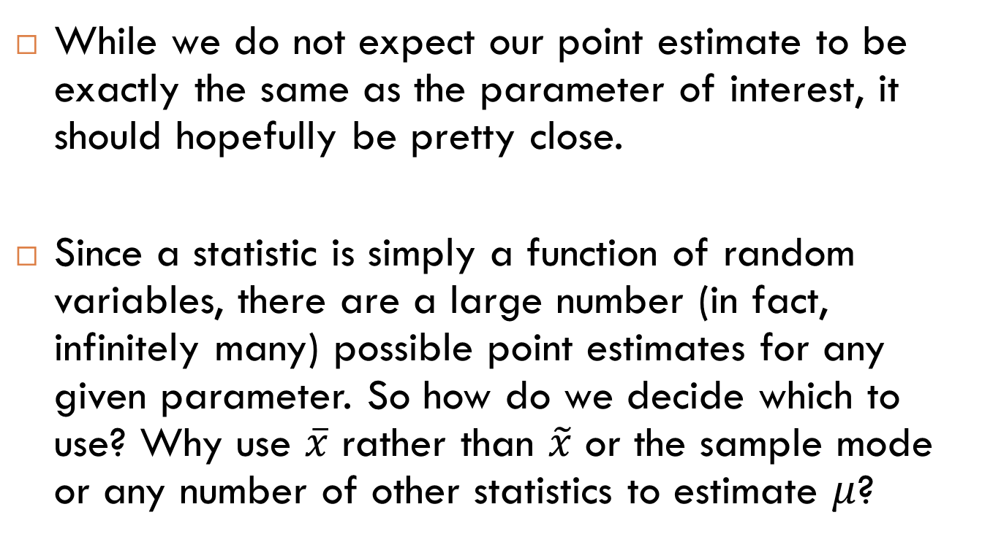
9.3 – Classical Estimation
While we do not expect our point estimate to be exactly the same as the parameter of interest, it should hopefully be pretty close.
Since a statistic is simply a function of random variables, there are a large number (in fact, infinitely many) possible point estimates for any given parameter. So how do we decide which to use? Why use $\overline{x}$ rather than $\tilde{x}$ or the sample mode or any number of other statistics to estimate $μ$?

Slide 6
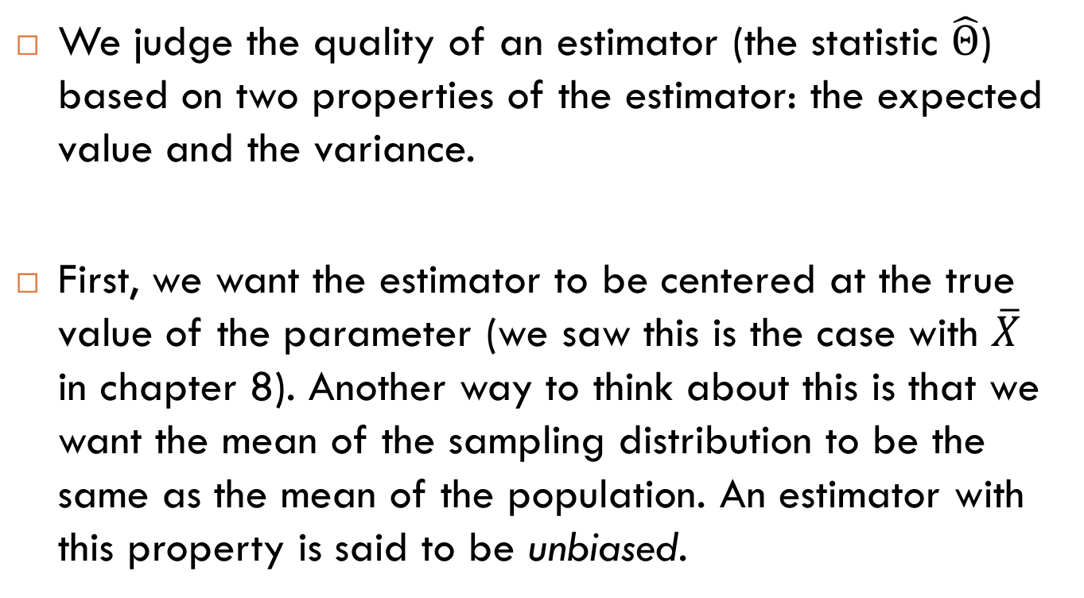
9.3 – Classical Estimation
We judge the quality of an estimator (the statistic $\hat{Θ}$) based on two properties of the estimator: the expected value and the variance.
First, we want the estimator to be centered at the true value of the parameter (we saw this is the case with $\overline{X}$ in chapter 8). Another way to think about this is that we want the mean of the sampling distribution to be the same as the mean of the population. An estimator with this property is said to be unbiased.

Slide 7
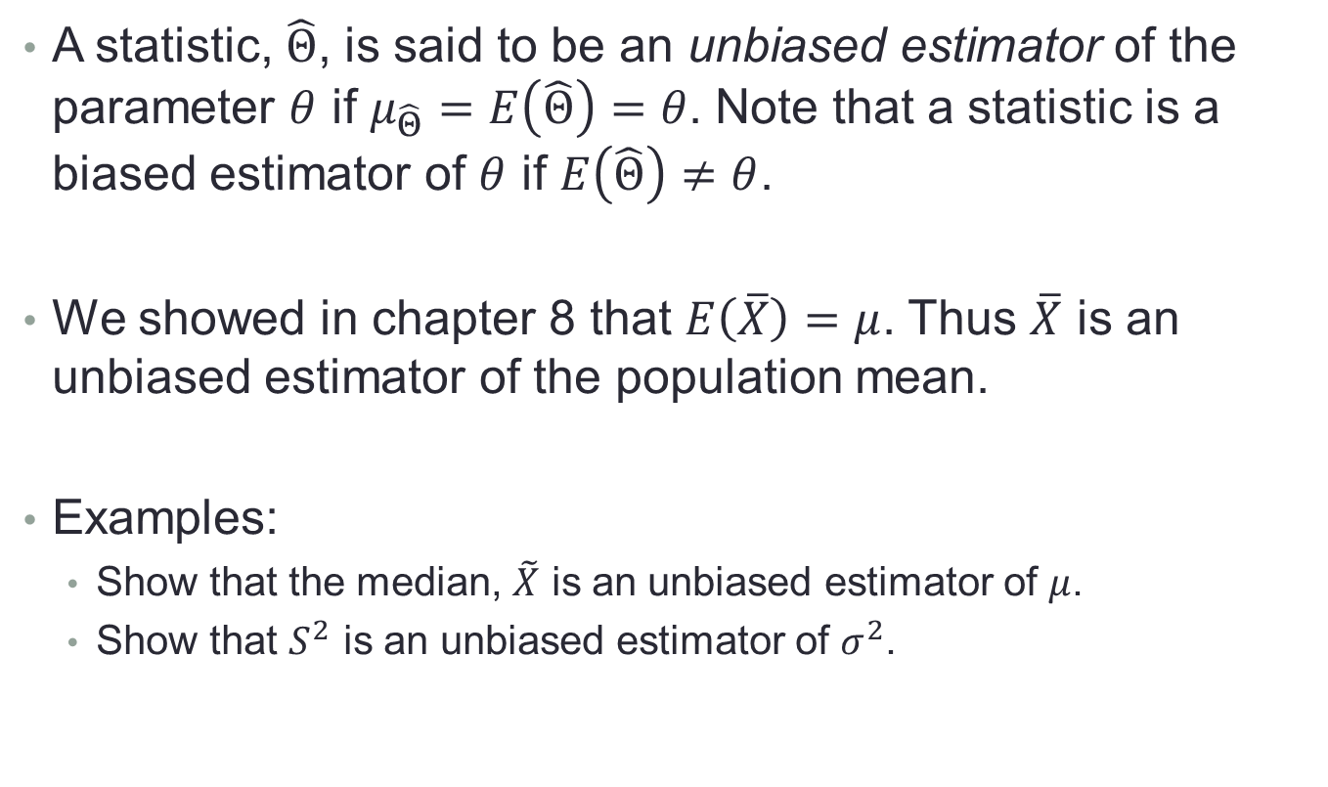
9.3 – Classical Estimation
A statistic, $\hat{Θ}$, is said to be an unbiased estimator of the parameter $θ$ if $μ_{\hat{Θ}}=E\left(\hat{Θ}\right)=θ$. Note that a statistic is a biased estimator of $θ$ if $E\left(\hat{Θ}\right)≠θ$.
We showed in chapter 8 that $E\left(\overline{X}\right)=μ$. Thus $\overline{X}$ is an unbiased estimator of the population mean.
Examples:
  Show that the median, $\tilde{X}$ is an unbiased estimator of $μ$.
  Show that $S^{2}$ is an unbiased estimator of $σ^{2}$.

Slide 8
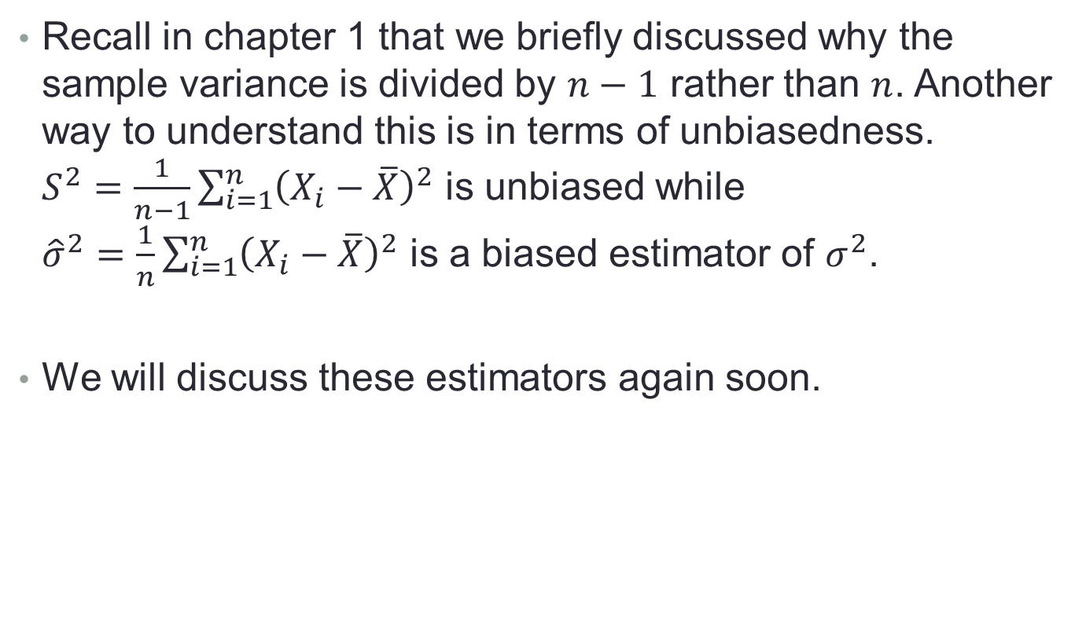
9.3 – Classical Estimation
Recall in chapter 1 that we briefly discussed why the sample variance is divided by $n−1$ rather than $n$. Another way to understand this is in terms of unbiasedness. $S^{2}=\frac{1}{n−1}\sum_{i=1}^{n}{{\left(X_{i}−\overline{X}\right)}^{2}}$ is unbiased while ${\hat{σ}}^{2}=\frac{1}{n}\sum_{i=1}^{n}{{\left(X_{i}−\overline{X}\right)}^{2}}$ is a biased estimator of $σ^{2}$.
We will discuss these estimators again soon.

Slide 9
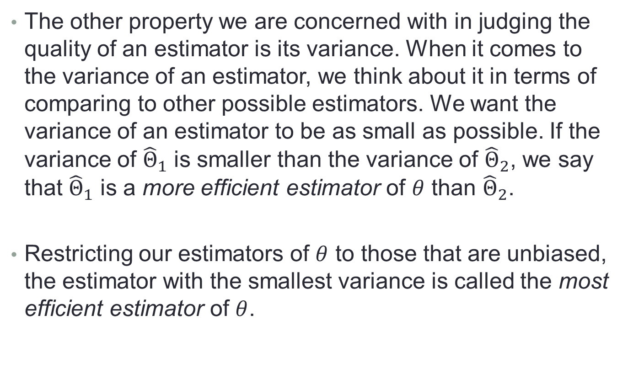
9.3 – Classical Estimation
The other property we are concerned with in judging the quality of an estimator is its variance. When it comes to the variance of an estimator, we think about it in terms of comparing to other possible estimators. We want the variance of an estimator to be as small as possible. If the variance of ${\hat{Θ}}_{1}$ is smaller than the variance of ${\hat{Θ}}_{2}$, we say that ${\hat{Θ}}_{1}$ is a more efficient estimator of $θ$ than ${\hat{Θ}}_{2}$.
Restricting our estimators of $θ$ to those that are unbiased, the estimator with the smallest variance is called the most efficient estimator of $θ$.

Slide 10

9.3 – Classical Estimation
Efficiency is the reason we typically use $\overline{X}$ to estimate $μ$ rather than $\tilde{X}$.
Exercise: Show that the variance of the sample mean is smaller than the variance of the sample median.

Slide 11
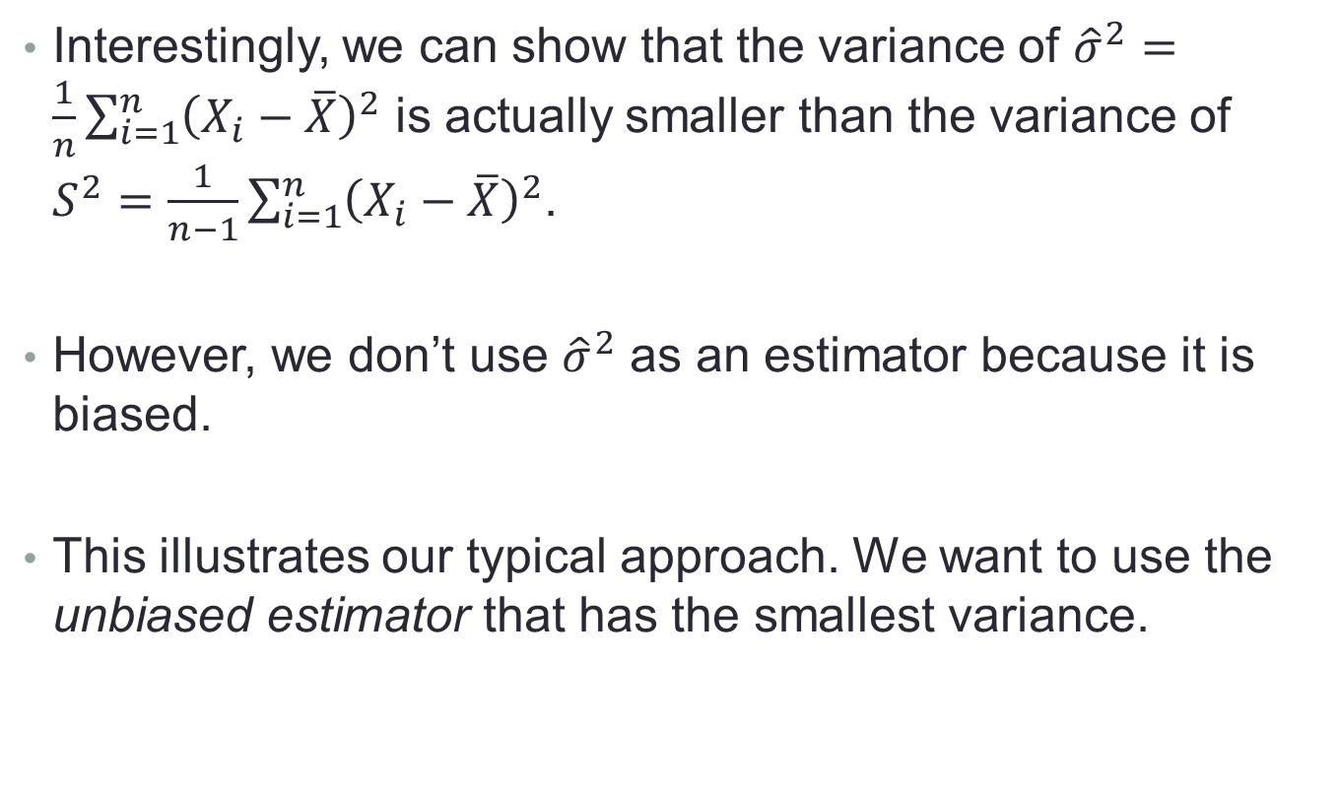
9.3 – Classical Estimation
Interestingly, we can show that the variance of ${\hat{σ}}^{2}=\frac{1}{n}\sum_{i=1}^{n}{{\left(X_{i}−\overline{X}\right)}^{2}}$ is actually smaller than the variance of $S^{2}=\frac{1}{n−1}\sum_{i=1}^{n}{{\left(X_{i}−\overline{X}\right)}^{2}}$.
However, we don’t use ${\hat{σ}}^{2}$ as an estimator because it is biased.
This illustrates our typical approach. We want to use the unbiased estimator that has the smallest variance.

Slide 12
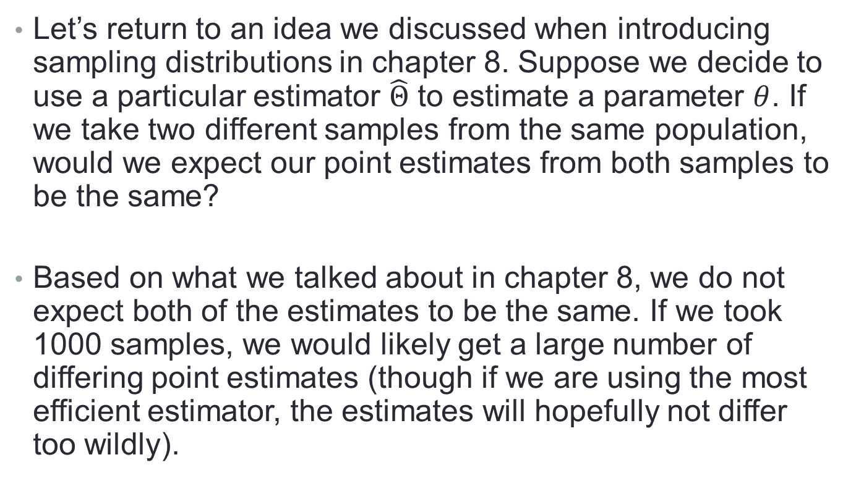
9.3 – Classical Estimation
Let’s return to an idea we discussed when introducing sampling distributions in chapter 8. Suppose we decide to use a particular estimator $\hat{Θ}$ to estimate a parameter $θ$. If we take two different samples from the same population, would we expect our point estimates from both samples to be the same?
Based on what we talked about in chapter 8, we do not expect both of the estimates to be the same. If we took 1000 samples, we would likely get a large number of differing point estimates (though if we are using the most efficient estimator, the estimates will hopefully not differ too wildly).

Slide 13
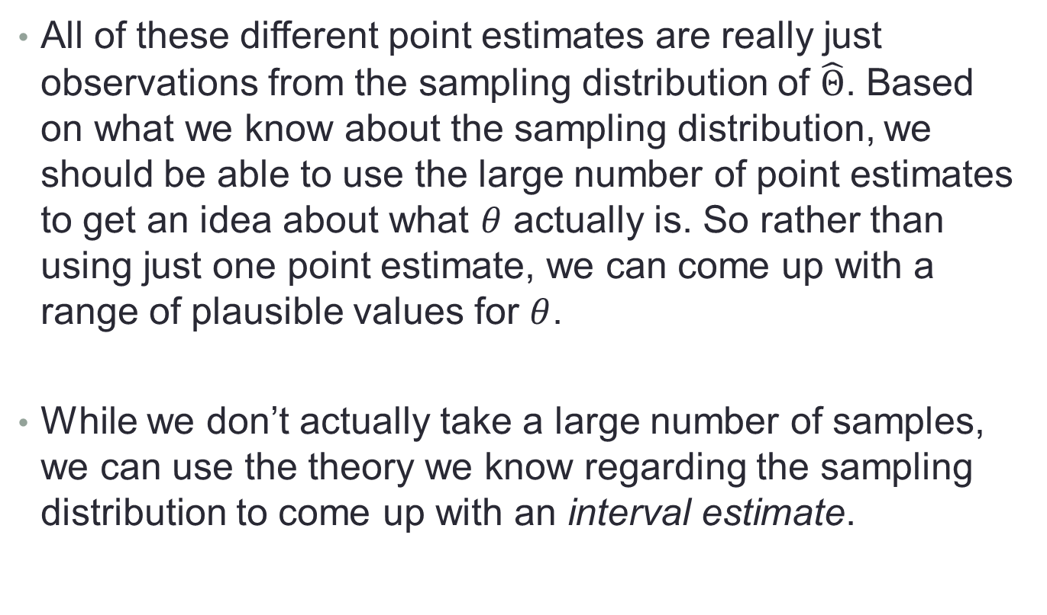
9.3 – Classical Estimation
All of these different point estimates are really just observations from the sampling distribution of $\hat{Θ}$. Based on what we know about the sampling distribution, we should be able to use the large number of point estimates to get an idea about what $θ$ actually is. So rather than using just one point estimate, we can come up with a range of plausible values for $θ$.
While we don’t actually take a large number of samples, we can use the theory we know regarding the sampling distribution to come up with an interval estimate.

Slide 14
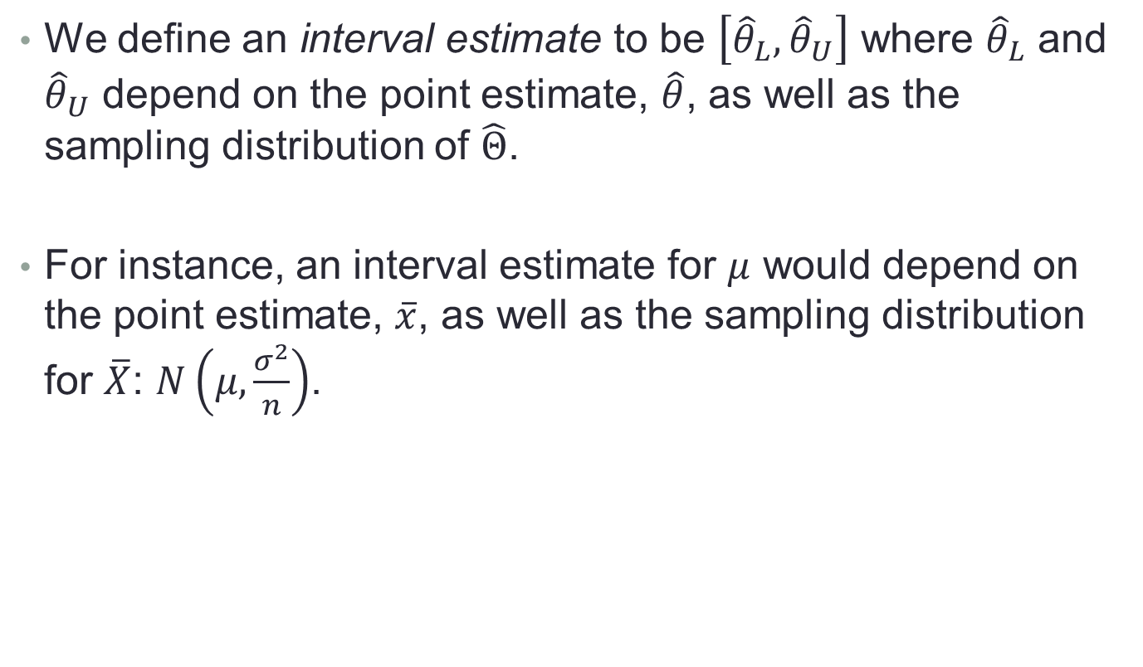
9.3 – Classical Estimation
We define an interval estimate to be $\left[{\hat{θ}}_{L}, {\hat{θ}}_{U}\right]$ where ${\hat{θ}}_{L}$ and ${\hat{θ}}_{U}$ depend on the point estimate, $\hat{θ}$, as well as the sampling distribution of $\hat{Θ}$.
For instance, an interval estimate for $μ$ would depend on the point estimate, $\overline{x}$, as well as the sampling distribution for $\overline{X}$: $N\left(μ,\frac{σ^{2}}{n}\right)$.

Slide 15
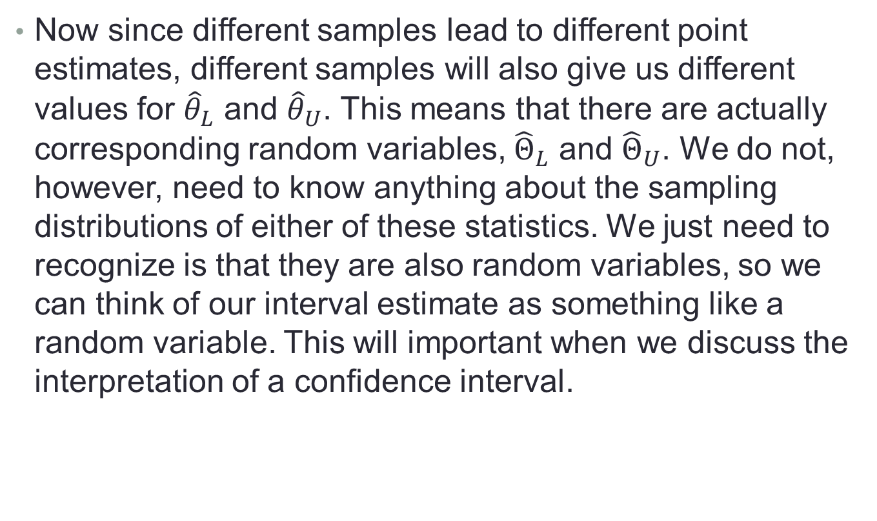
9.3 – Classical Estimation
Now since different samples lead to different point estimates, different samples will also give us different values for ${\hat{θ}}_{L}$ and ${\hat{θ}}_{U}$. This means that there are actually corresponding random variables, ${\hat{Θ}}_{L}$ and ${\hat{Θ}}_{U}$. We do not, however, need to know anything about the sampling distributions of either of these statistics. We just need to recognize is that they are also random variables, so we can think of our interval estimate as something like a random variable. This will important when we discuss the interpretation of a confidence interval.

Slide 16
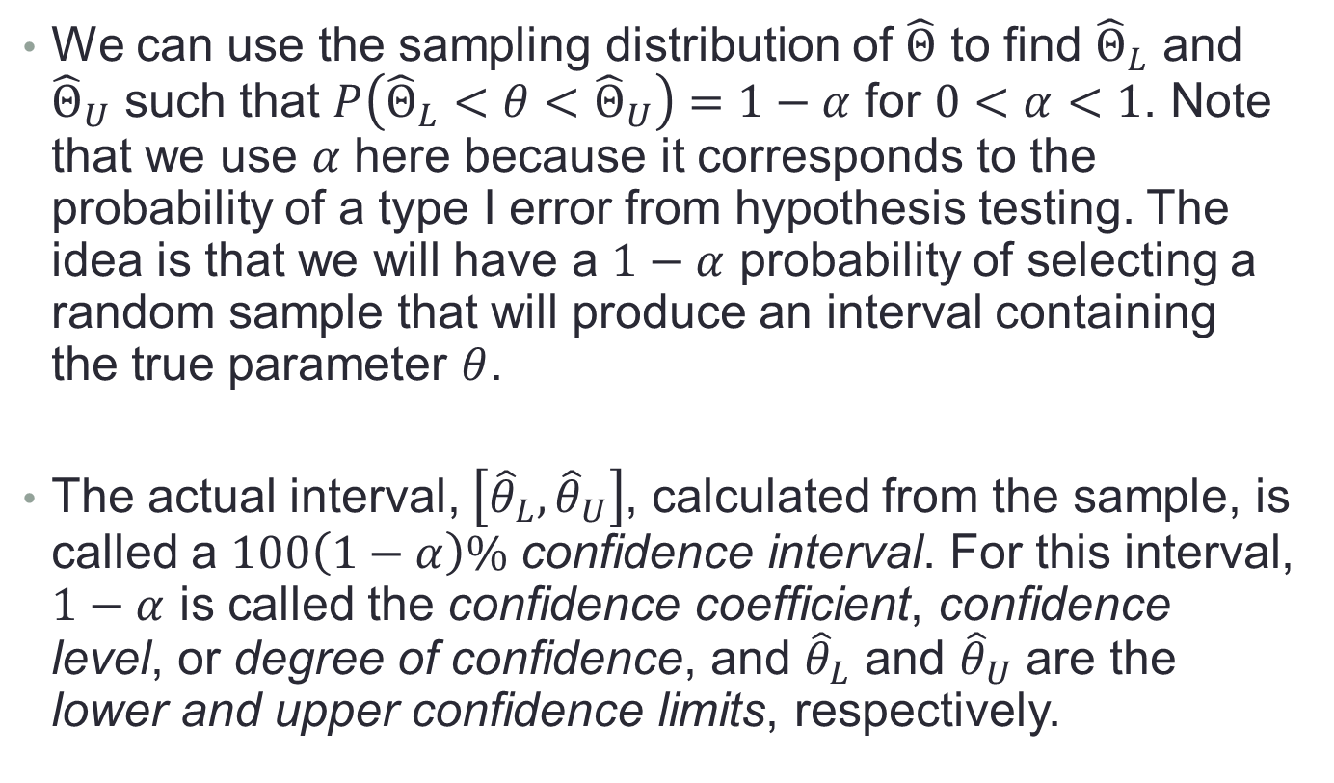
9.3 – Classical Estimation
We can use the sampling distribution of $\hat{Θ}$ to find ${\hat{Θ}}_{L}$ and ${\hat{Θ}}_{U}$ such that $P\left({\hat{Θ}}_{L}<θ<{\hat{Θ}}_{U}\right)=1−α$ for $0<α<1$. Note that we use $α$ here because it corresponds to the probability of a type I error from hypothesis testing. The idea is that we will have a $1−α$ probability of selecting a random sample that will produce an interval containing the true parameter $θ$.
The actual interval, $\left[{\hat{θ}}_{L}, {\hat{θ}}_{U}\right]$, calculated from the sample, is called a $100\left(1−α\right)\%$ confidence interval. For this interval, $1−α$ is called the confidence coefficient, confidence level, or degree of confidence, and ${\hat{θ}}_{L}$ and ${\hat{θ}}_{U}$ are the lower and upper confidence limits, respectively.

Slide 17

9.3 – Classical Estimation
Looking at the sampling distribution of $\hat{Θ}$, what is going to happen to the width of the interval if we increase the confidence level?

Slide 18
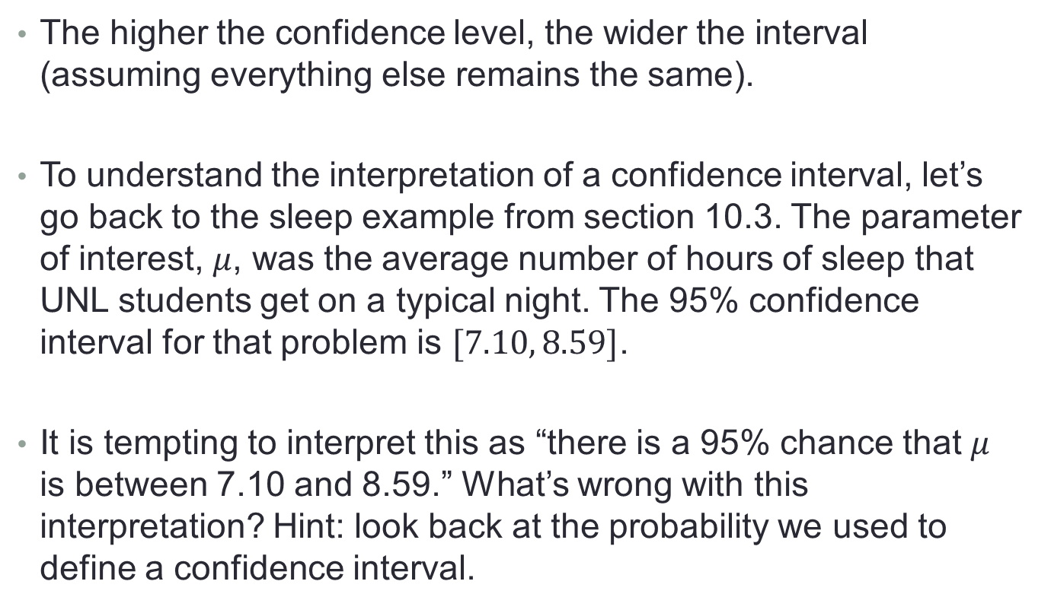
9.3 – Classical Estimation
The higher the confidence level, the wider the interval (assuming everything else remains the same).
To understand the interpretation of a confidence interval, let’s go back to the sleep example from section 10.3. The parameter of interest, $μ$, was the average number of hours of sleep that UNL students get on a typical night. The 95% confidence interval for that problem is $[7.10, 8.59]$.
It is tempting to interpret this as “there is a 95% chance that $μ$ is between 7.10 and 8.59.” What’s wrong with this interpretation? Hint: look back at the probability we used to define a confidence interval.

Slide 19
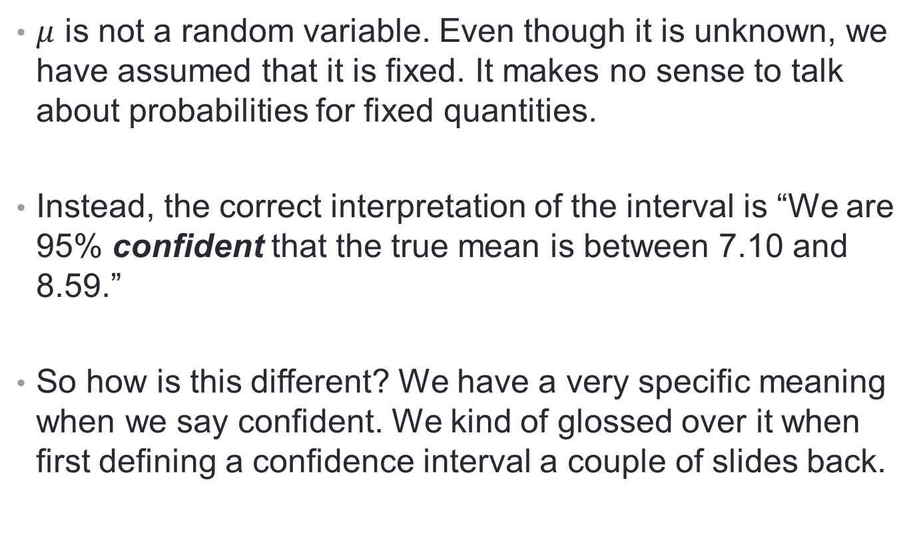
9.3 – Classical Estimation
$μ$ is not a random variable. Even though it is unknown, we have assumed that it is fixed. It makes no sense to talk about probabilities for fixed quantities.
Instead, the correct interpretation of the interval is “We are 95% confident that the true mean is between 7.10 and 8.59.”
So how is this different? We have a very specific meaning when we say confident. We kind of glossed over it when first defining a confidence interval a couple of slides back.

Slide 20
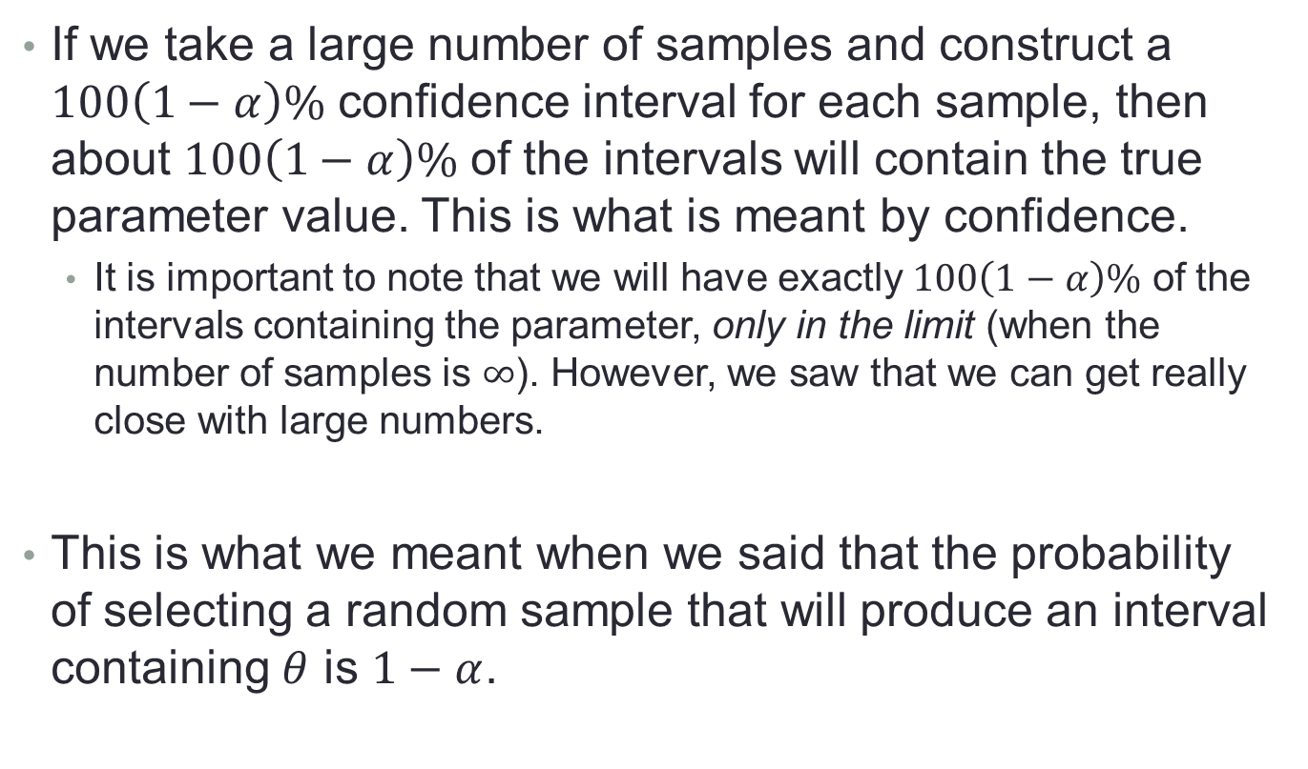
9.3 – Classical Estimation
If we take a large number of samples and construct a $100\left(1−α\right)\%$ confidence interval for each sample, then about $100\left(1−α\right)\%$ of the intervals will contain the true parameter value. This is what is meant by confidence.
  It is important to note that we will have exactly $100\left(1−α\right)\%$ of the intervals containing the parameter, only in the limit (when the number of samples is $∞$). However, we saw that we can get really close with large numbers.
This is what we meant when we said that the probability of selecting a random sample that will produce an interval containing $θ$ is $1−α$.

Slide 21
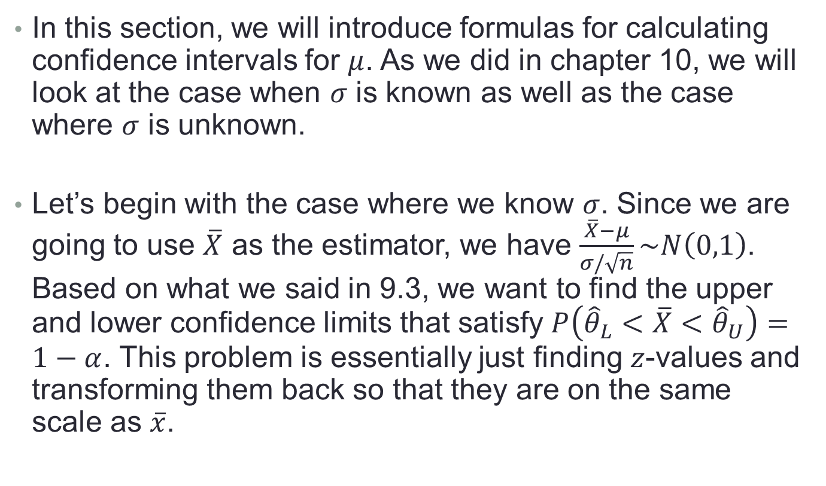
9.4 – Single Sample: Estimating the Mean
In this section, we will introduce formulas for calculating confidence intervals for $μ$. As we did in chapter 10, we will look at the case when $σ$ is known as well as the case where $σ$ is unknown.
Let’s begin with the case where we know $σ$. Since we are going to use $\overline{X}$ as the estimator, we have $\frac{\overline{X}−μ}{σ/\sqrt{n}}\sim N\left(0,1\right)$. Based on what we said in 9.3, we want to find the upper and lower confidence limits that satisfy $P\left({\hat{θ}}_{L}<\overline{X}<{\hat{θ}}_{U}\right)=1−α$. This problem is essentially just finding $z$-values and transforming them back so that they are on the same scale as $\overline{x}$.

Slide 22
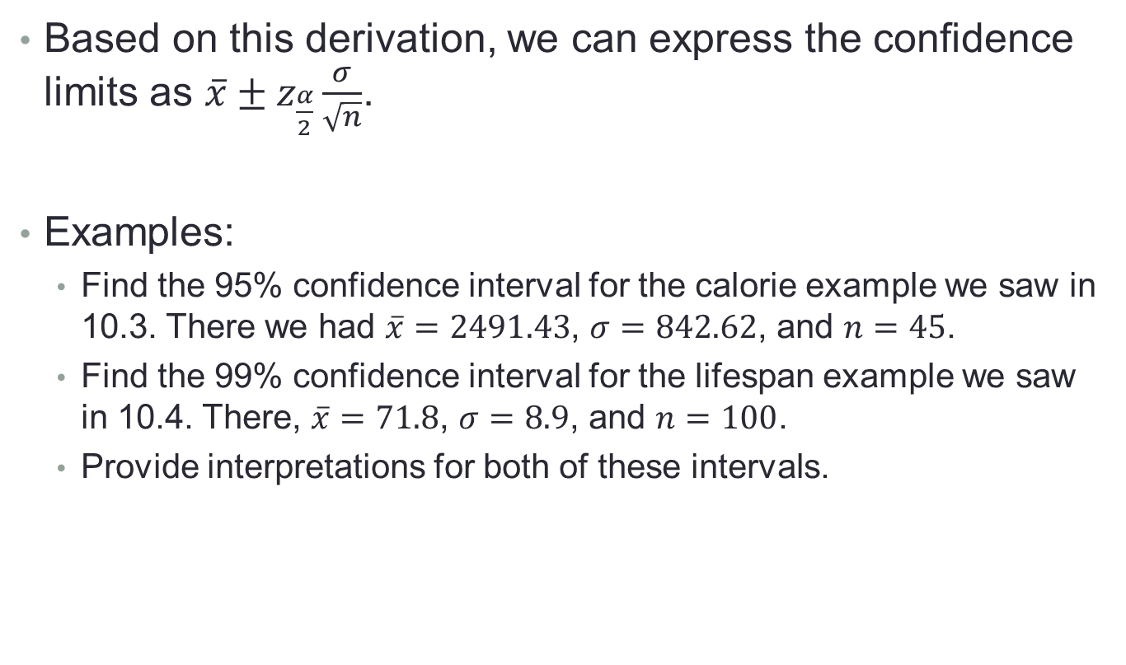
9.4 – Single Sample: Estimating the Mean
Based on this derivation, we can express the confidence limits as $\overline{x}±z_{\frac{α}{2}}\frac{σ}{\sqrt{n}}$.
Examples:
  Find the 95% confidence interval for the calorie example we saw in 10.3. There we had $\overline{x}=2491.43$, $σ=842.62$, and $n=45$.
  Find the 99% confidence interval for the lifespan example we saw in 10.4. There, $\overline{x}=71.8$, $σ=8.9$, and $n=100$.
  Provide interpretations for both of these intervals.

Slide 23
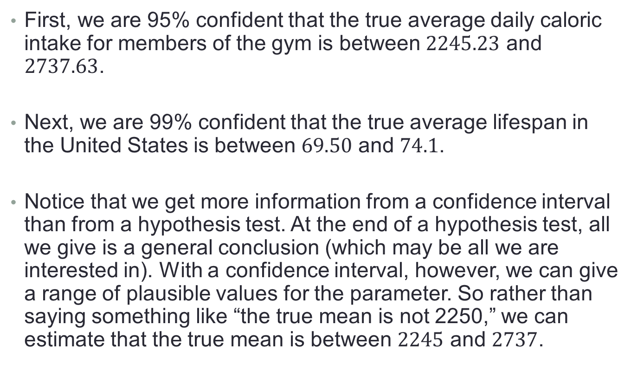
9.4 – Single Sample: Estimating the Mean
First, we are 95% confident that the true average daily caloric intake for members of the gym is between $2245.23$ and $2737.63$.
Next, we are 99% confident that the true average lifespan in the United States is between $69.50$ and $74.1$.
Notice that we get more information from a confidence interval than from a hypothesis test. At the end of a hypothesis test, all we give is a general conclusion (which may be all we are interested in). With a confidence interval, however, we can give a range of plausible values for the parameter. So rather than saying something like “the true mean is not 2250,” we can estimate that the true mean is between $2245$ and $2737$.

Slide 24
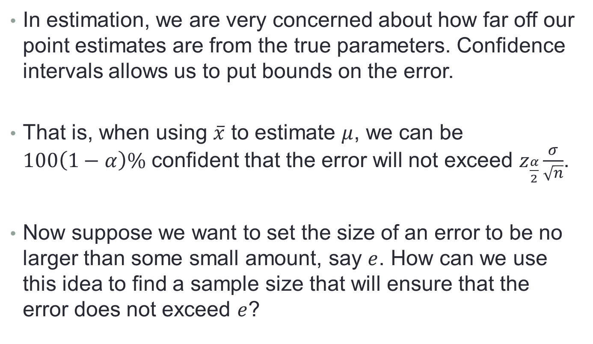
9.4 – Single Sample: Estimating the Mean
In estimation, we are very concerned about how far off our point estimates are from the true parameters. Confidence intervals allows us to put bounds on the error.
That is, when using $\overline{x}$ to estimate $μ$, we can be $100\left(1−α\right)\%$ confident that the error will not exceed $z_{\frac{α}{2}}\frac{σ}{\sqrt{n}}$.
Now suppose we want to set the size of an error to be no larger than some small amount, say $e$. How can we use this idea to find a sample size that will ensure that the error does not exceed $e$?

Slide 25
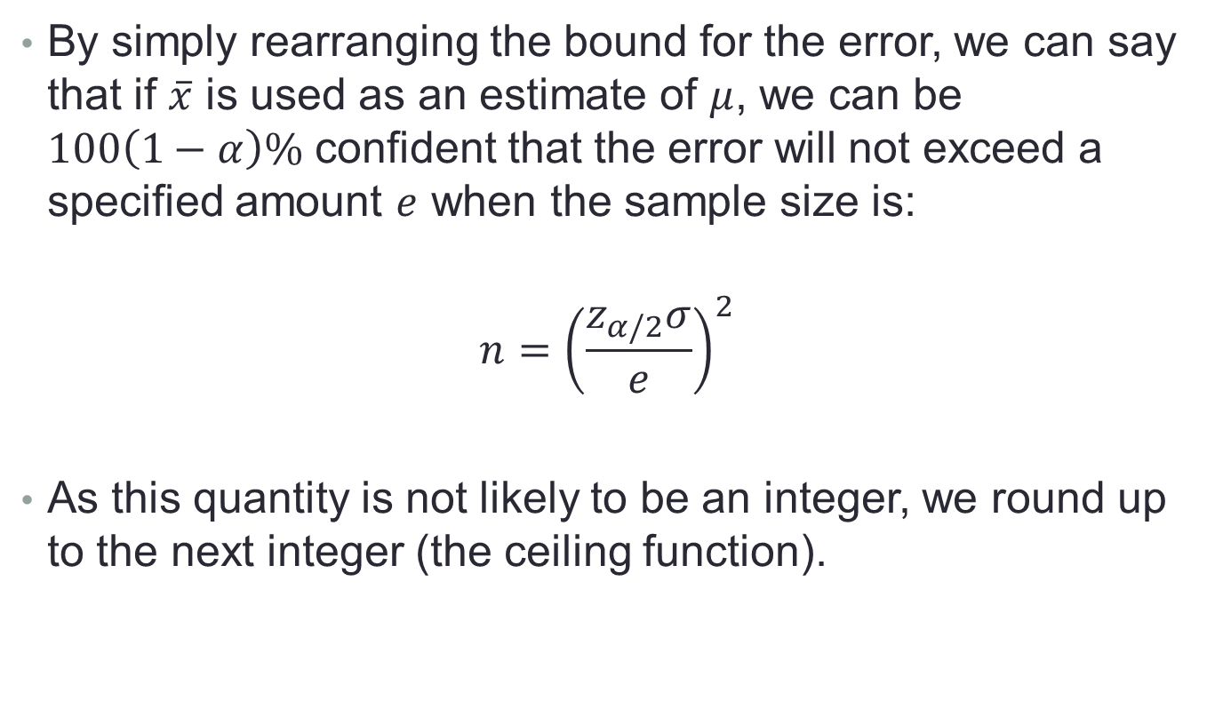
9.4 – Single Sample: Estimating the Mean
By simply rearranging the bound for the error, we can say that if $\overline{x}$ is used as an estimate of $μ$, we can be $100\left(1−α\right)\%$ confident that the error will not exceed a specified amount $e$ when the sample size is:
$$n={\left(\frac{z_{α/2}σ}{e}\right)}^{2}$$
As this quantity is not likely to be an integer, we round up to the next integer (the ceiling function).

Slide 26

9.4 – Single Sample: Estimating the Mean
Example: For the lifespan example ($\overline{x}=71.8, σ=8.9, n=100,α=0.01$), find:
  The bound for the error
  The sample size necessary to make the error no bigger than 1.5.

Slide 27
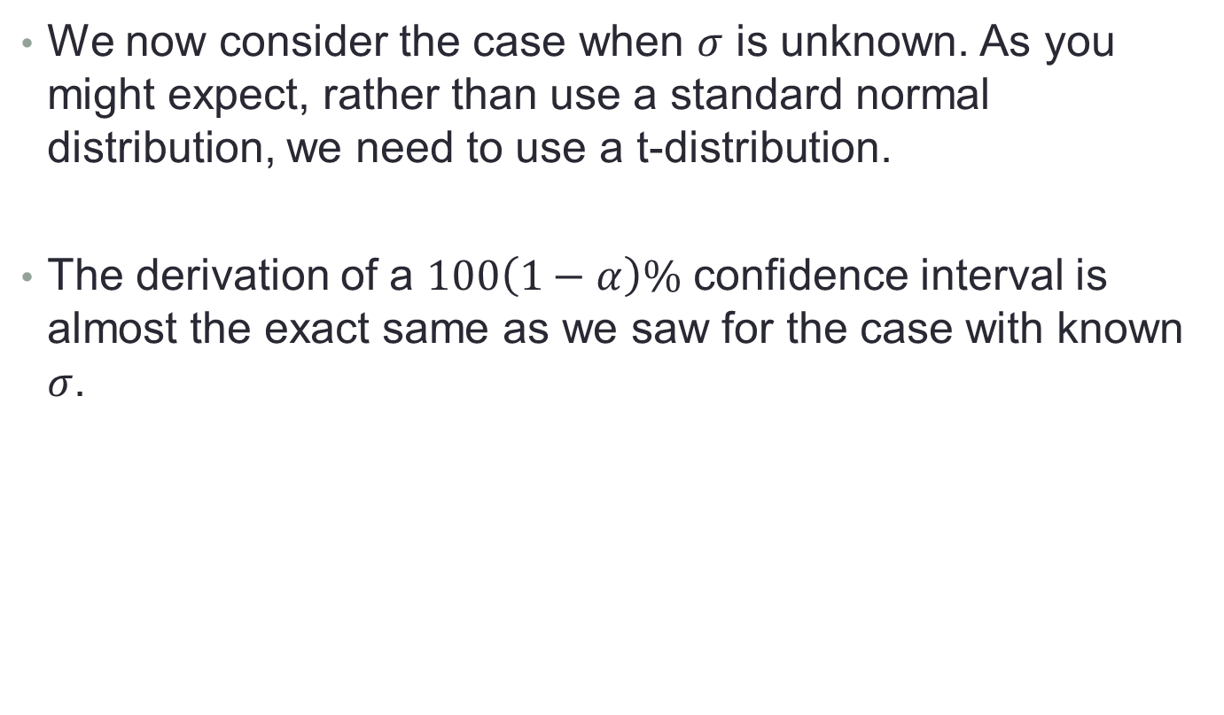
9.4 – Single Sample: Estimating the Mean
We now consider the case when $σ$ is unknown. As you might expect, rather than use a standard normal distribution, we need to use a t-distribution.
The derivation of a $100\left(1−α\right)\%$ confidence interval is almost the exact same as we saw for the case with known $σ$.

Slide 28

9.4 – Single Sample: Estimating the Mean
So, the $100\left(1−α\right)\%$ confidence interval for the mean when $σ$ is unknown is given by $\overline{x}±t_{\frac{α}{2}}\frac{s}{\sqrt{n}}$.
The interpretation of the resulting interval is exactly the same as we saw previously.

Slide 29
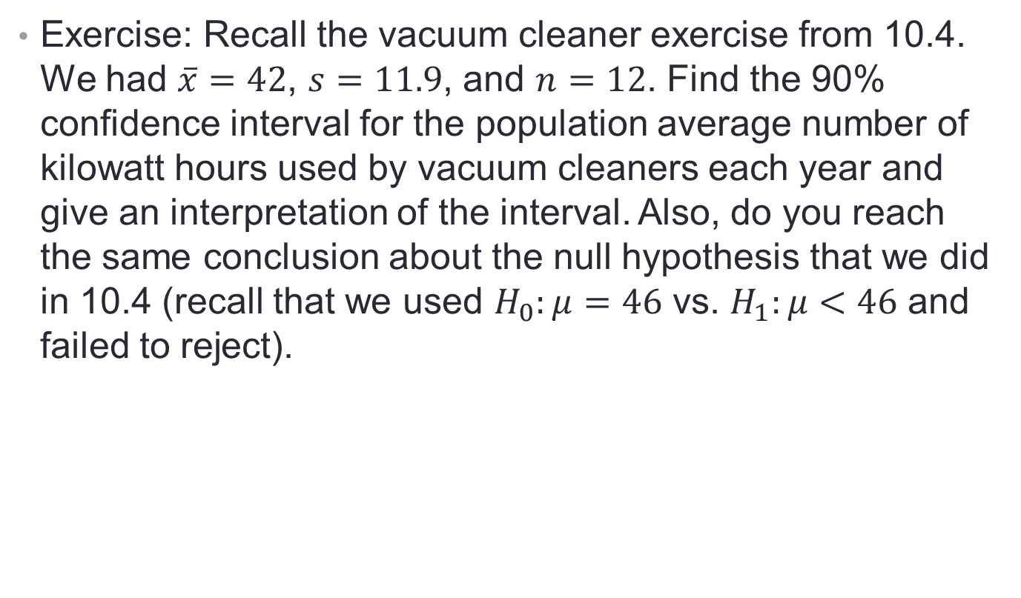
9.4 – Single Sample: Estimating the Mean
Exercise: Recall the vacuum cleaner exercise from 10.4. We had $\overline{x}=42$, $s=11.9$, and $n=12$. Find the 90% confidence interval for the population average number of kilowatt hours used by vacuum cleaners each year and give an interpretation of the interval. Also, do you reach the same conclusion about the null hypothesis that we did in 10.4 (recall that we used $H_{0}:μ=46$ vs. $H_{1}:μ<46$ and failed to reject).

Slide 30
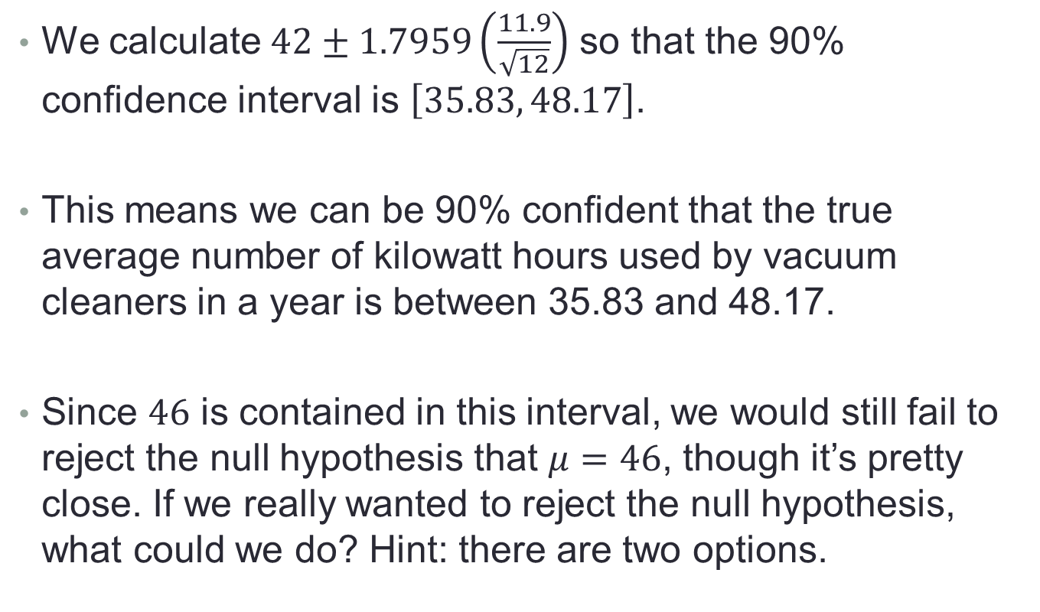
9.4 – Single Sample: Estimating the Mean
We calculate $42±1.7959\left(\frac{11.9}{\sqrt{12}}\right)$ so that the 90% confidence interval is $\left[35.83, 48.17\right]$.
This means we can be 90% confident that the true average number of kilowatt hours used by vacuum cleaners in a year is between 35.83 and 48.17.
Since $46$ is contained in this interval, we would still fail to reject the null hypothesis that $μ=46$, though it’s pretty close. If we really wanted to reject the null hypothesis, what could we do? Hint: there are two options.

Slide 31
9.4 – Single Sample: Estimating the Mean
We could decrease the confidence level (not good statistical practice), or we could increase the sample size. Both of these changes would reduce the width of the confidence interval.

Slide 32
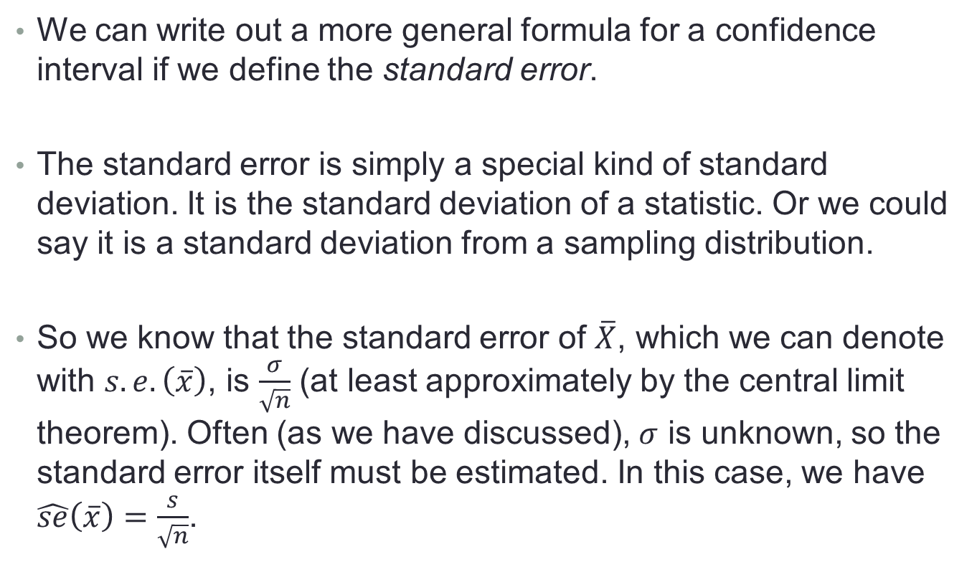
9.5 – Standard Error of a Point Estimate
We can write out a more general formula for a confidence interval if we define the standard error.
The standard error is simply a special kind of standard deviation. It is the standard deviation of a statistic. Or we could say it is a standard deviation from a sampling distribution.
So we know that the standard error of $\overline{X}$, which we can denote with $s.e.\left(\overline{x}\right)$, is $\frac{σ}{\sqrt{n}}$ (at least approximately by the central limit theorem). Often (as we have discussed), $σ$ is unknown, so the standard error itself must be estimated. In this case, we have $\hat{se}\left(\overline{x}\right)=\frac{s}{\sqrt{n}}$.

Slide 33
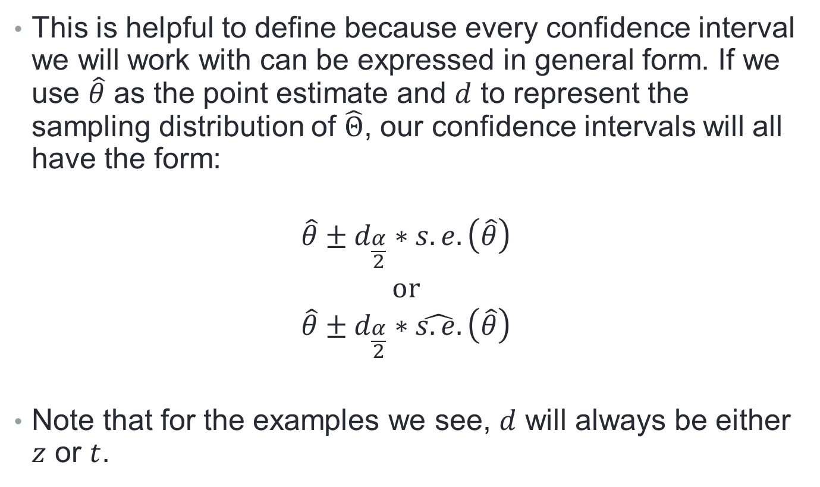
9.5 – Standard Error of a Point Estimate
This is helpful to define because every confidence interval we will work with can be expressed in general form. If we use $\hat{θ}$ as the point estimate and $d$ to represent the sampling distribution of $\hat{Θ}$, our confidence intervals will all have the form:
$$\hat{θ}±d_{\frac{α}{2}}∗s.e.\left(\hat{θ}\right)$$
$$or$$
$$\hat{θ}±d_{\frac{α}{2}}∗\hat{s.e.}\left(\hat{θ}\right)$$
Note that for the examples we see, $d$ will always be either $z$ or $t$.

